Slide 1
The Relational Model of Data
CSIT882: Data Management Systems
Notes:
<!-- Neural, Brian, Male, British English. -->
<speak>
<break time="0.5s"/>
<prosody rate="90%">
The relational model of data.
<break time="0.3s"/>
This video presents the basic concepts of the relational data model, commonly used as a logical view of data, in database systems.
<break time="0.5s"/>
</prosody>
</speak>
Systems Analysis

Slide 2
Outline
Basic Concepts
Relational Table
Principles of Relational Model
Consistency Constraints
Summary
Notes:
<!-- Neural, Brian, Male, British English. -->
<speak>
<break time="0.5s"/>
<prosody rate="90%">
Basic concepts.
<break time="0.5s"/>
</prosody>
</speak>
Systems Analysis

Slide 3
Basic Concepts
Data model ? What is it ?
A data model provides an abstract view of data that can be used for data definition, data manipulation, data retrieval, and data administration
A data model organises data elements and standardises how the data elements relate to one another
Because a data model provides an abstract view it is also commonly called as an abstract view of data
In the past we talked about the following views of data:
- Sector, track, cylinder
- Sequence of data blocks
- Record, file, file system
- Two dimensional tables (tabular view), Hierarchies (tree view), Networks (graph view)
- Classes of objects, associations, attributes
Notes:
<!-- Neural, Brian, Male, British English. -->
<speak>
<break time="0.5s"/>
<prosody rate="90%">
What is a data model ?
<break time="0.3s"/>
As it has been explained earlier, a data model provides a database user with an abstract view of data.
<break time="0.3s"/>
Such abstract view of data, can be used for the purpose of: data definition, data manipulation, data retrieval, and data administration in a database system.
<break time="0.3s"/>
A data model organises data elements, and standardises how the data elements relate to one another.
<break time="0.3s"/>
A data model also provides a set of operations, that can be used to manipulate and to retrieve data.
<break time="0.3s"/>
Because a data model provides an abstract view, it is also called as an abstract view of data.
<break time="0.3s"/>
In the past, we discussed the following views of data.
<break time="0.3s"/>
At a hardware level, we talked about sectors, tracks, and cylinders.
<break time="0.3s"/>
At a physical level, we talked about sequences of data blocks.
<break time="0.3s"/>
At a file level, we talked about records, files and file systems.
<break time="0.3s"/>
At a logical level, we talked about tables, hierarchies, and networks.
<break time="0.3s"/>
At a conceptual level we talked about classes of objects, associations, attributes, and generalisation hierarchies.
<break time="0.5s"/>
</prosody>
</speak>
Systems Analysis

Slide 4
Basic Concepts
In 1970 E.F. Codd from IBM Corp. defined a model of data based on a tabular view of and called it as Relational Model of Data or simply Relational Model
At the moment ~95% of all database systems is based on Relational Model of Data
However, it is important to say that in the past and now Relational Model of Data had and still has few serious contenders like Object-Oriented Model, Object-Relational Model, XML Data Model, and recently JSON Data Model
Notes:
<!-- Neural, Brian, Male, British English. -->
<speak>
<break time="0.5s"/>
<prosody rate="90%>
In 1970 Edgar Frank Codd from IBM Corporation defined a model of data based on a tabular view of data and called it as Relational Model of Data.
<break time="0.3s"/>
In the future we refer to it as to Relational Data Model.
<break time="0.3s"/>
At the moment approximately 95% of all database systems is based on Relational Data Model.
<break time="0.3s"/>
However, it is important to say, that in the past and now Relational Data Model had and still has few serious contenders like Object-Oriented Model, Object-Relational Model, XML Data Model, and recently JSON Data Model.
<break time="0.5s"/>
</prosody>
</speak>
Systems Analysis

Slide 5
Basic Concepts
What view of data provides the Relational Model of Data ?
- The model provide a tabular view of data where a database consists of so called “relational tables”
- A relational table consists of a header and theoretically an unlimited number of rows
- A header consists of a sequence of attribute names
- A row consists of a sequence of of values of attributes
- A vertical sequence, that starts from an attribute name in a header and it is followed by the attribute values is called a column
- A header is also called as a relational schema
- A set of all values of an attribute is called as a domain of such attribute
- A database is a set of relational tables
Notes:
<!-- Neural, Brian, Male, British English. -->
<speak>
<break time="0.5s"/>
<prosody rate="90%">
What view of data provides the relational data model ?
<break time="0.3s"/>
The model provides a tabular view of data, where a database consists of so called relational tables.
<break time="0.3s"/>
A relational table consists of a header, and theoretically unlimited number of rows.
<break time="0.3s"/>
A header consists of a sequence of attribute names.
<break time="0.3s"/>
A row consists of a sequence of values of attributes.
<break time="0.3s"/>
A vertically oriented sequence, that starts from an attribute name in a header, and it is followed by the attribute values in the rows, is called as a column.
<break time="0.3s"/>
A header, is also called as a relational schema.
<break time="0.3s"/>
A set of all values of an attribute, is called as a domain of such attribute.
<break time="0.3s"/>
A database is a set of the relational tables.
<break time="0.3s"/>
</prosody>
</speak>
Systems Analysis

Slide 6
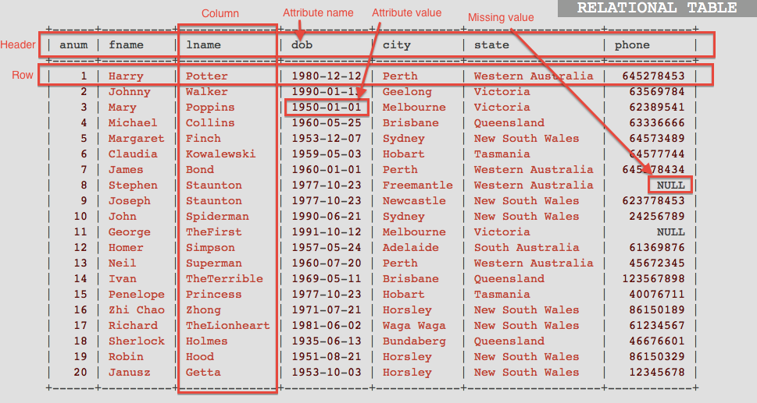
Basic Concepts
A sample relational table:
Notes:
<!-- Neural, Brian, Male, British English. -->
<speak>
<break time="0.5s"/>
<prosody rate="90%">
A picture in the slide shows a sample relational table.
<break time="0.3s"/>
The relational table contains information about the employees.
<break time="0.3s"/>
A header of the relational table contains the names of attributes describing the employees.
<break time="0.3s"/>
An employee is described by a unique number (anum), first name (fname), last name (lname), date of birth (d o b), and address, that consists of city name (city), and state (state), and phone number (phone).
<break time="0.3s"/>
The rows below a header, contain the values of attributes describing employees.
<break time="0.3s"/>
A single row describes a single employee.
<break time="0.3s"/>
A symbol: NULL, represents an empty slot in a table.
<break time="0.3s"/>
An empty slot in a table, is interpreted as a lack of value of an attribute.
<break time="0.3s"/>
It may happen, that a value of an attribute is unknown, or an attribute is not applicable to a description of a real world object.
<break time="0.3s"/>
Then, it is impossible to record a value of an attribute.
<break time="0.3s"/>
A vertical sequence, that start from a name of attribute in a header and the values of an attribute below is called as a column.
<break time="0.5s"/>
</prosody>
</speak>
Systems Analysis

Slide 7
Basic Concepts
Why a relational table is called as a "relational" ?
This is because of the following original E.F. Codd's definition of a relational table:
Let A₁, A₂, ... , A_{n} be the names of attributes
Let dom(A₁), dom(A₂), ... , dom(An) be the domains of the attributes, i.e. the sets of values of each attribute A₁, A₂, ... , A_{n}
A relational table is defined as a subset of Cartesian product
dom(A₁) x dom(A₂) x … x dom(A_{n})
In mathematics a subset of the Cartesian product is known as a relation
This is why a relational table is called as "relational"
The original definition of a relational table is not correct because two tables with the different orders of columns contain the same information however two relations with different order of domains are different
Notes:
<!-- Neural, Brian, Male, British English. -->
<speak>
<break time="0.5s"/>
<prosody rate="90%">
Why a relational table is called as "relational" ?
<break time="0.3s"/>
This is due to the following original Codd's definition of a relational table.
<break time="0.3s"/>
Let A 1, A 2, A n, be the names of attributes.
<break time="0.3s"/>
Let dom of A 1, dom of A 2, dom of A n be the domains of the attributes, domains mean the sets of values of attributes A 1 , A 2, A n.
<break time="0.3s"/>
A relational table is defined as a subset of the following Cartesian product.
<break time="0.3s"/>
dom of A 1 crossed with dom of A 2 crossed with dom of A n
<break time="0.3s"/>
In mathematics, a subset of Cartesian product is called as a "relation".
<break time="0.3s"/>
And this is why a relational table is called as "relational".
<break time="0.3s"/>
The original definition of a relational table is not completely correct.
<break time="0.3s"/>
This is because two relational tables with the different orders of columns contain the same information.
<break time="0.3s"/>
However, two relations with a different order of domains involved in a Cartesian product are different.
<break time="0.3s"/>
In the next presentation, we show a definition of a relational table, that more precisely matches reality.
<break time="0.5s"/>
</prosody>
</speak>
Systems Analysis

Slide 8
Outline
Basic Concepts
Relational Table
Principles of Relational Model
Consistency Constraints
Summary
Notes:
<!-- Neural, Brian, Male, British English. -->
<speak>
<break time="0.5s"/>
<prosody rate="90%">
Relational table.
<break time="0.5s"/>
</prosody>
</speak>
Systems Analysis

Slide 9
Relational Table
A correct definition of relational tables is the following:
- Let A₁, A₂, ... A_{n} be the names of attributes
Let dom(A₁), dom(A₂), ... dom(A_{n}) be the domains of attributes, i.e. the sets of values of each attribute A₁, A₂, ... A_{n}
A row r is a full mapping
r: {A₁, A₂, ... A_{n}} → dom(A₁) U dom(A₂) U ... dom(A_{n}) such that for all A in {A₁, A₂, ... A_{n}}, r(A) is in dom(A)
A relational table is defined as a set of rows
Now, an order of columns is immaterial, but ... a name "relational" is not well justified ;)
Notes:
<!-- Neural, Brian, Male, British English. -->
<speak>
<break time="0.5s"/>
<prosody rate="90%">
A more precise definition of a relational table, that is consistent with the reality, is the following.
<break time="0.3s"/>
Let A 1, A 2, A n be the names of attributes.
<break time="0.3s"/>
Let dom of A 1, dom of A 2, dom of A n be the domains of attributes, it means the sets of values of attributes A 1, A 2, A n
<break time="0.3s"/>
A row r is defined as a full mapping of attribute names A 1, A 2, A n into a union of domains dom of A 1, dom of A 2, dom of A n such that for all A in a set of attributes A 1, A 2, A n, r of attribute A is in a domain of attribute A.
<break time="0.3s"/>
A relational table is still defined as a set of rows.
<break time="0.3s"/>
Now, an order of columns is immaterial, because we can swap the attributes in the mapping but, ... a name "relational" is not well justified.
<break time="0.5s"/>
</prosody>
</speak>
Systems Analysis

Slide 10
Outline
Basic Concepts
Relational Table
Principles of Relational Model
Consistency Constraints
Summary
Notes:
<!-- Neural, Brian, Male, British English. -->
<speak>
<break time="0.5s"/>
<prosody rate="90%">
The principles of the relational data model.
<break time="0.5s"/>
</prosody>
</speak>
Systems Analysis

Slide 11
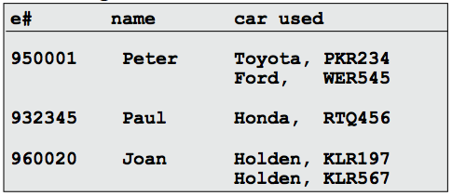
Principles of Relational Model
A relational table that has no multivalued attributes and composite attributes is in the first normal form (1NF)
For example, a relational table below is NOT in 1NF, sometimes we say that such table is in 0NF
Are there any higher normal forms like for example 2NF, 3NF, ... ?
YES ! However, we shall not discuss this topic now !
Is 0NF completely useless ?
NO ! However, we shall not discuss this topic in this subject !
Notes:
<!-- Neural, Brian, Male, British English. -->
<speak>
<break time="0.5s"/>
<prosody rate="90%">
A relational table, that has no multivalued, and composite attributes, is in the first normal form, it is also denoted as 1 N F.
<break time="0.3s"/>
For example, a relational table in the slide is NOT in 1 N F because it contains composite values of attributes in a column: car used and also sets of values in a column: car used.
<break time="0.3s"/>
For example, a composite value is a pair Toyota, P K R 2 3 4 in a column: car used.
<break time="0.3s"/>
A set of values consists if two composite values in a column: car used.
<break time="0.3s"/>
We can also say, that such table is in zeroth normal form, 0 N F, or, that it is a nested table.
<break time="0.3s"/>
We shall not use the nested relational tables in this subject.
<break time="0.3s"/>
Are there any higher normal forms like for example 2 N F or 3 N F ?
<break time="0.3s"/>
Yes ! However, we shall not discuss this topic now !
<break time="0.3s"/>
Is a nested relational table in 0 N F completely useless ?
<break time="0.3s"/>
No ! However, we shall not discuss this topic in this subject !
<break time="0.3s"/>
</prosody>
</speak>
Systems Analysis

Slide 12
Principles of Relational Model
Access to the rows by the contents rule:
- We can only retrieve the rows by their contents
- It is NOT allowed to say: give me the second row from the following table:
+------+----------+--------------+------------+------------+-------------------+
| anum | fname | lname | dob | city | state |
+------+----------+--------------+------------+------------+-------------------+
| 1 | Harry | Potter | 1980-12-12 | Perth | Western Australia |
| 2 | Johnny | Walker | 1990-01-13 | Geelong | Victoria |
| 3 | Mary | Poppins | 1950-01-01 | Melbourne | Victoria |
| 4 | Michael | Collins | 1960-05-25 | Brisbane | Queensland |
| 5 | Margaret | Finch | 1953-12-07 | Sydney | New South Wales |
| 6 | Claudia | Kowalewski | 1959-05-03 | Hobart | Tasmania |
| 7 | James | Bond | 1960-01-01 | Perth | Western Australia |
| 8 | Stephen | Staunton | 1977-10-23 | Freemantle | Western Australia |
| 9 | Joseph | Staunton | 1977-10-23 | Newcastle | New South Wales |
| 10 | John | Spiderman | 1990-06-21 | Sydney | New South Wales |
+------+----------+--------------+------------+------------+-------------------+
- We have to say: give me a row such that anum = 2 or such that fname = 'Johnny' and lname = 'Walker'
Notes:
<!-- Neural, Brian, Male, British English. -->
<speak>
<break time="0.5s"/>
<prosody rate="90%">
An important principle of the relational data model, is access to the rows by the contents rule.
<break time="0.3s"/>
The rule says, that we can only retrieve the rows by their contents, and we cannot refer to their physical locations in a relational table.
<break time="0.3s"/>
It means, that it is NOT allowed to say, give me the second row from a relational table given in the current slide.
<break time="0.3s"/>
Instead we can say: give me a row such that a value of an attribute a num equals 2, or such that a value of attribute f name equals to 'Johnny', and a value of attribute l name equals to 'Walker'.
<break time="0.5s"/>
</prosody>
</speak>
Systems Analysis

Slide 13
Principles of Relational Model
Unique rows rule:
- A relational table cannot contain two identical rows
This rule is violated by all commercial Database Management Systems !
Notes:
<!-- Neural, Brian, Male, British English. -->
<speak>
<break time="0.5s"/>
<prosody rate="90%">
The next rule is, the unique rows rule.
<break time="0.3s"/>
The rule says, that a relational table cannot contain two identical rows.
<break time="0.3s"/>
This is, because a relational table is defined as a set of rows, and a set cannot contain to identical elements.
<break time="0.3s"/>
This rule is violated by all commercial Database Management Systems !
<break time="0.5s"/>
</prosody>
</speak>
Systems Analysis

Slide 14
Outline
Basic Concepts
Relational Table
Principles of Relational Model
Consistency Constraints
- Keys
- NULL
- Referential Integrity Constraints
- Domain Constraints
Summary
Notes:
<!-- Neural, Brian, Male, British English. -->
<speak>
<break time="0.5s"/>
<prosody rate="90%">
Consistency constraints.
<break time="0.3s"/>
Keys.
<break time="0.5s"/>
</prosody>
</speak>
Systems Analysis

Slide 15
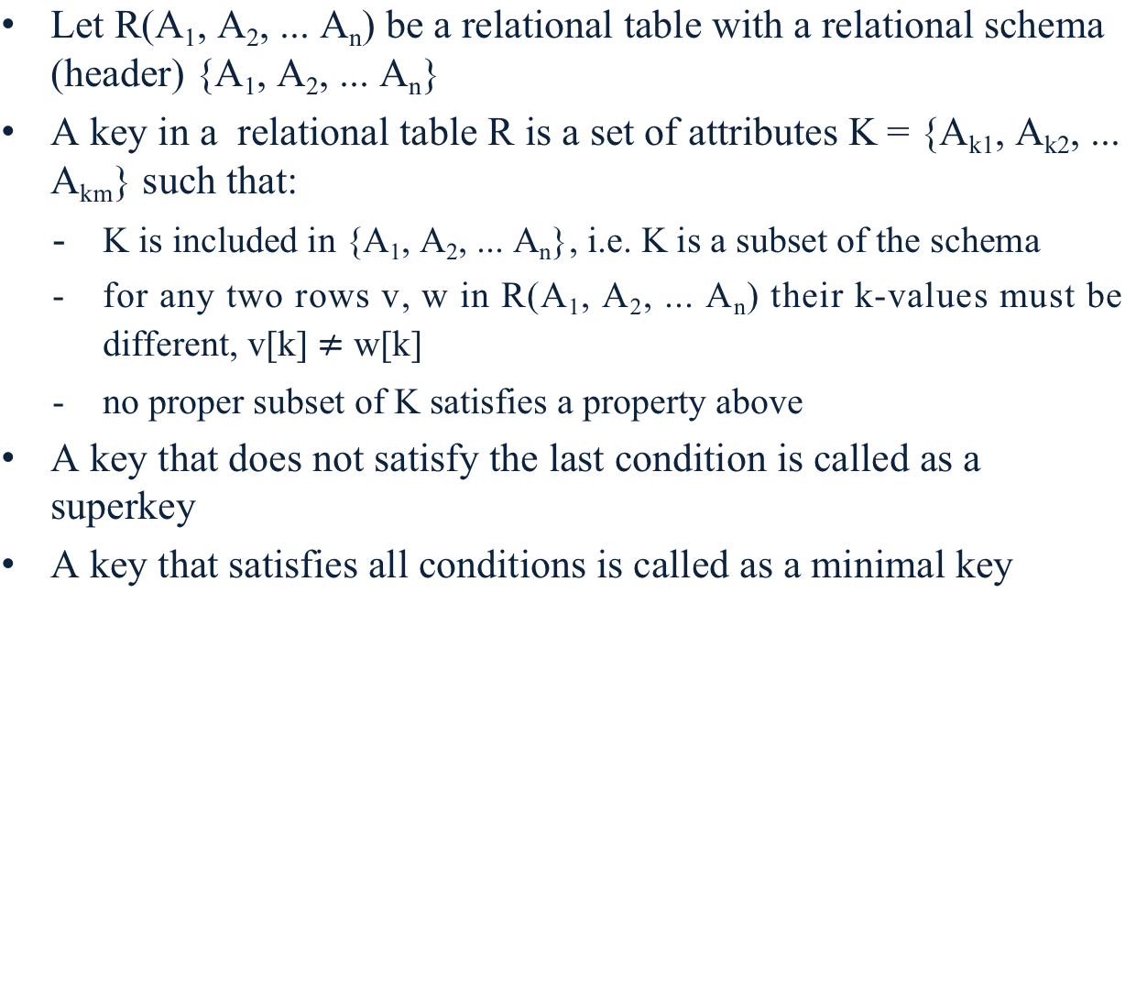
Keys
Let R(A₁, A₂, ... A_{n}) be a relational table with a relational schema (header) {A₁, A₂, ... A_{n}}
A key in a relational table R is a set of attributes K = {A_{k1}, A_{k2}, ... A_{km}} such that:
- K is included in {A₁, A₂, ... A_{n}}, i.e. K is a subset of the schema
for any two rows v, w in R(A₁, A₂, ... A_{n}) their k-values must be different, v[k] $≠$ w[k]
no proper subset of K satisfies a property above
A key that does not satisfy the last condition is called as a superkey
A key that satisfies all conditions is called as a minimal key
Notes:
<!-- Neural, Brian, Male, British English. -->
<speak>
<break time="0.5s"/>
<prosody rate="90%">
Let R, of A 1, A 2, ..., A n be a relational table with a relational schema (header), that consists of the attributes A 1, A 2, ..., A n.
<break time="0.3s"/>
A key in a relational table R is a set of attributes K equal to A k 1, A k 2, ..., A k m, such that:
<break time="0.3s"/>
first, K is included in a set A 1, A 2, ..., A n, and it means, that K is a subset of the schema.
<break time="0.3s"/>
second, for any two rows v, w, in a relational table R, of A1, A2, ..., A n, their k-values must be different, a projection of v on a set of attributes k must be different from w of k.
<break time="0.3s"/>
third, no proper subset of k, satisfies a property above.
<break time="0.3s"/>
A key, that does not satisfy the last condition, is called a superkey.
<break time="0.3s"/>
A key, that satisfies all conditions, is called a minimal key.
<break time="0.3s"/>
</prosody>
</speak>
Systems Analysis

Slide 16
Keys
Examples:
- A set of attributes {snum} is a minimal key in a relational schema STUDENT={snum, first-name, last-name, date-of-birth}
- A set of attributes {snum, last-name} is a superkey in a relational schema STUDENT={snum, first-name, last-name, date-of-birth}
- A set of attributes {snum, code, enrolment-date, enrolment-time} is a minimal key in a relational schema
ENROLMENT={snum, code, enrolment-date, enrolment-time}
- A set of attributes {bldg#, room#} is a minimal key in a relational schema ROOM={bldg#, room#, area}
- A set of attributes {p#, manufacturer, price} is a superkey in a relational schema PART={p#, name, price, manufacturer}
- A set of attributes {p#, manufacturer} is a superkey in a relational schema PART={p#, name, price, manufacturer}
- A set of attributes {p#} is a minimal key in a relational schema
PART={p# name, price, manufacturer}
Notes:
<!-- Neural, Brian, Male, British English. -->
<speak>
<break time="0.5s"/>
<prosody rate="90%">
Let us look at few examples of minimal keys, and superkeys, valid in the relational schemas.
<break time="0.3s"/>
First, we consider relational schema: students, that consists of the attributes: student number (s num), first name, last name and date of birth.
<break time="0.3s"/>
A set of attributes, that contains only a student number, is a minimal key in a relational schema: student.
<break time="0.3s"/>
It is, because every student has a unique student number given by university administration when he/she is enrolled.
<break time="0.3s"/>
It is a minimal key, because it is impossible to remove an attribute, such that a remaining set of attributes is not empty.
<break time="0.3s"/>
A set of attributes, that contains only the attributes: student number and last name, is a superkey in a relational schema: student.
<break time="0.3s"/>
It is a key, because every student has a unique pair of values of attributes: student number and last name.
<break time="0.3s"/>
It is a superkey, because if we remove an attribute: last name, a remaining set of attributes, that contains only a student number, is still a key.
<break time="0.3s"/>
Well, it is even a minimal key.
<break time="0.5s"/>
</prosody>
</speak>
<!-- Neural, Brian, Male, British English. -->
<speak>
<break time="0.5s"/>
<prosody rate="90%">
Next, consider a relational schema: enrolment, that consists of the attributes: student number (s num), subject code (code) enrolment date, and enrolment time measured with a precision up to a single milisecond.
<break time="0.3s"/>
A set of attributes: student number (s num), code, enrolment date and enrolment-time, is a minimal key in a relational schema: enrolment.
<break time="0.3s"/>
This is so, because a student can enrol in only one subject, on a given day, and in a given moment in time,
<break time="0.3s"/>
It is a minimal key, because we cannot remove any attributes such, that the remaining set of attributes, still remain a minimal key.
<break time="0.3s"/>
For example, if we remove enrolment time, then it is possible that a student enrolled in a subject, dropped the same subject, and enrolled in it again on the same day.
<break time="0.3s"/>
Next, we consider a relational schema: room, that consists of the attributes: building number (bldg#), room number (room#), and room area.
<break time="0.3s"/>
A set of attributes: building number and room number, is a minimal key in a relational schema: room.
<break time="0.3s"/>
It is so, because all rooms in a building must have unique numbers.
<break time="0.3s"/>
A set of attributes: building number, room number, and room area is a superkey.
<break time="0.3s"/>
It is, because we can remove an attribute area: and a pair of attributes left: building number and room number is still a key.
<break time="0.3s"/>
Finally, let us consider a relational schema: part, that consists of the attributes part number (p#), part name, price, and part manufacturer.
<break time="0.3s"/>
A set of attributes, that consists of: part number, manufacturer, and price, is a superkey in a relational schema: part.
<break time="0.3s"/>
It is so, because if we remove an attribute: price, then a pair of attributes: part number and manufacturer, is a key in a relational schema: part.
<break time="0.3s"/>
A set of attributes that consists of: part number, and manufacturer, is a superkey in a relational schema: part.
<break time="0.3s"/>
It is so because if we remove manufacturer then a part number is a key in a relational schema part.
<break time="0.3s"/>
Finally, a set of attributes, that consists only of: part number, is a minimal key in a relational schema: part.
<break time="0.5s"/>
</prosody>
</speak>
Systems Analysis

Slide 17
Keys
More examples:
A set of attributes {pnum, first-name,last-name, dob, team} is a superkey in a relational schema
PLAYER={pnum, first-name, last-name, dob, team}
A set of attributes {pnum, first-name,last-name, dob} is a superkey in a relational schema
PLAYER={pnum, first-name, last-name, dob, team}
A set of attributes {first-name,last-name, dob} is a minimal key in a relational schema
PLAYER={pnum, first-name, last-name, dob, team}
- A set of attributes {supplier-num, part-num, delivery-date, delivery-address} is a minimal key in a relational schema
SHIPMENT={supplier-num, part-num, delivery-date, delivery-address}
Notes:
<!-- Neural, Brian, Male, British English. -->
<speak>
<break time="0.5s"/>
<prosody rate="90%">
Let us look at more examples of superkeys and minimal keys.
<break time="0.3s"/>
A relational schema: player, consists of the attributes: player number (p number), first name, last name, date of birth (d o b ), and team name.
<break time="0.3s"/>
A set of attributes, that consists of: player number, first name, last name, date of birth, and team, is a superkey in a relational schema: player.
<break time="0.3s"/>
A set of attributes, that consists of: player number, first name, last name, and date of birth, is a superkey in a relational schema: player.
<break time="0.3s"/>
A set of attributes, that consists of: first name, last name, and date of birth, is a minimal key in a relational schema: player.
<break time="0.3s"/>
A relational schema shipment consists of the attributes: supplier number, (supplier num), part number (part num), delivery date, and delivery address.
<break time="0.3s"/>
A set of attributes, that consists of: supplier number, part number, delivery date, and delivery address, is a minimal key in a relational schema: shipment.
<break time="0.5s"/>
</prosody>
</speak>
Systems Analysis

Slide 18
Keys
All minimal keys valid in a relational schema are also called candidate keys
A primary key is one of the candidate keys arbitrarily [ˈɑrbɪˌtrɛrəli] chosen by a database designer to uniquely identify the rows in a relational table
- A set of attributes {snum} and a set of attributes {first-name, last-name, date-of-birth} are the candidate keys in a relational schema STUDENT={snum, first-name, last-name, date-of- birth}
- A candidate key {snum} can be selected by a database designer as a primary key
- It is also possible that a candidate key {first-name, last-name, date-of-birth} can be selected by a database designer as a primary key
In the future a relational schema R ={A₁, A₂, ... A_{n}} will be denoted by R(A₁, A₂, ... A_{n}) and any key {A_{i1}, A_{i2}, ... A_{im}} included in R will be denoted by (A_{i1}, A_{i2}, ... A_{im})
Notes:
<!-- Neural, Brian, Male, British English. -->
<speak>
<break time="0.5s"/>
<prosody rate="90%">
All minimal keys valid in a relational schema are also called as candidate keys.
<break time="0.3s"/>
A primary key is one of the candidate keys arbitrarily chosen by a database designer, to uniquely identify the rows in a relational table.
<break time="0.3s"/>
A set of attributes that consists of: student number (s num) is a candidate key in a relational schema: student.
<break time="0.3s"/>
A set of attributes, that consists of: first name, last name, and date of birth is a composite candidate key in a relational schema: student.
<break time="0.3s"/>
A candidate key: student number, can be selected by a database designer as a primary key.
<break time="0.3s"/>
It is also possible, that a candidate key that consists of the attributes: first name, last name, and date of birth, is selected by a database designer as a primary key.
<break time="0.3s"/>
In the future, a relational schema will be denoted by R of A 1, A 2, ... A n, and any key: A i 1, A i 2, ... A i m, included in R will be denoted by left bracket A i 1, A i 2, ... A i m, right bracket.
<break time="0.5s"/>
</prosody>
</speak>
Systems Analysis

Slide 19
Outline
Basic Concepts
Relational Table
Principles of Relational Model
Consistency Constraints
- Keys
- NULL
- Referential Integrity Constraints
- Domain Constraints
Summary
Notes:
<!-- Neural, Brian, Male, British English. -->
<speak>
<break time="0.5s"/>
<prosody rate="90%">
Consistency constraints.
<break time="0.3s"/>
NULL, a lack of value.
<break time="0.5s"/>
</prosody>
</speak>
Systems Analysis

Slide 20
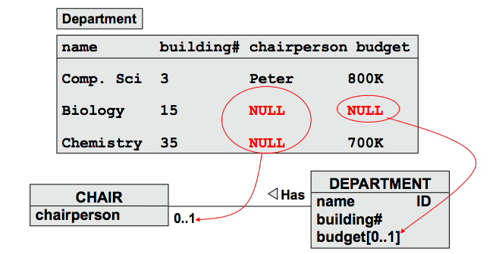
NULL
A NULL constraint says that an attribute in a relational table may have no values at all
An Entity Integrity constraint says, that no column belonging to a primary key or candidate key is allowed to take on NULL for any row.
All commercial Database Management Systems allow NULL for candidate keys
Notes:
<!-- Neural, Brian, Male, British English. -->
<speak>
<break time="0.5s"/>
<prosody rate="90%">
A NULL constraint says, that an attribute in a relational table may have no values at all.
<break time="0.3s"/>
Consider a conceptual schema, where a class: department, is related to class: chair, through an association: department has chair.
<break time="0.3s"/>
Because a multiplicity of the association on a chair class side is zero or one, then it may happen, that a department has no chairperson.
<break time="0.3s"/>
In such situation, some values in a column: chairperson, in a relational table: department, can be missing.
<break time="0.3s"/>
A lack of value in a slot of a relational table, is represented by a symbol: NULL.
<break time="0.3s"/>
An attribute: budget, is an optional attribute in a description of a class: department.
<break time="0.3s"/>
If a department has no budget, then such situation is represented by a NULL symbol in a column: budget, in a relational table: department.
<break time="0.3s"/>
An Entity Integrity constraint says, that no column belonging to a primary key, or candidate key is allowed to take on NULL for any row.
<break time="0.3s"/>
All commercial Database Management Systems allow NULLs for the candidate keys.
<break time="0.5s"/>
</prosody>
</speak>
Systems Analysis

Slide 21
Outline
Basic Concepts
Relational Table
Principles of Relational Model
Consistency Constraints
- Keys
- NULL
- Referential Integrity Constraints
- Domain Constraints
Summary
Notes:
<!-- Neural, Brian, Male, British English. -->
<speak>
<break time="0.5s"/>
<prosody rate="90%">
Consistency constraints.
<break time="0.3s"/>
Referential integrity constraints.
<break time="0.5s"/>
</prosody>
</speak>
Systems Analysis

Slide 22
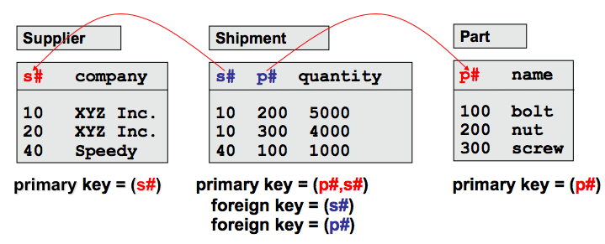
Referential Integrity Constraints
A set of attributes F in a relational schema R is called as a foreign key if the combination of values of attributes in F in any row is required to either contain NULLs or else to match the value combination of a set of columns P representing a candidate or primary key in some other relational schema S
Notes:
<!-- Neural, Brian, Male, British English. -->
<speak>
<break time="0.5s"/>
<prosody rate="90%">
A referential integrity constraint says, that a set of attributes F, in a relational schema R, is called a foreign key, if a combination of values of attributes in F, in any row is required to either contain NULLs or else to match the value combination of a set of columns P, representing a candidate or primary key in some other relational schema S.
<break time="0.3s"/>
For example, an attribute supplier number (s#), in a relational schema: shipment, is a foreign key referencing a primary key: supplier number (s#), in a relational schema supplier.
<break time="0.3s"/>
It means, that a column: supplier number (s#), in a relational table: shipment, must contain only the values already inserted into a column: supplier number (s#,) in a relational table: supplier.
<break time="0.3s"/>
In this case, a value in a column: supplier number (s#), in a table: shipment, cannot be missing ( null ), because an attribute: supplier number, is a component of a primary key in a relational table: shipment.
<break time="0.3s"/>
In another example, an attribute" part number (p#), in a relational schema: shipment, is a foreign key referencing a primary key: part number (p#), in a relational schema part.
<break time="0.3s"/>
It means, that a column: part number (p#) in a relational table: shipment, must contain only the values already inserted into a column: part number (p#), in a relational table: part.
<break time="0.3s"/>
In this case, a value in column: part number (p#), in a table: shipment, cannot be missing ( null ), because an attribute: supplier number, is a component of a primary key in a relational table: shipment.
<break time="0.5s"/>
</prosody>
</speak>
Systems Analysis

Slide 23
Referential Integrity Constraints
Referential integrity rule is in force, if the columns of foreign keys in any relational table either:
- (1) have NULLs in at least one column that allows NULLs
- (2) have no NULLs and a combination of all its values is equal to the combination of primary key values in the other relational table
Notes:
<!-- Neural, Brian, Male, British English. -->
<speak>
<break time="0.5s"/>
<prosody rate="90%">
A referential integrity rule is in force, if the columns of foreign keys in any relational table, either:
have NULLs in at least one column, that allows NULLs, or have no NULLs, and a combination of all its values is equal to the combination of primary key values in the other relational table.
<break time="0.3s"/>
It means, that the values in the columns: supplier number (s#) and part number (p#), must be earlier inserted into the columns: supplier number (s#) and part number (p#), in the relational tables: supplier and part.
<break time="0.3s"/>
The columns: supplier number (s#) and part number(p#), cannot have empty slots (NULLs) because both attributes are the members of a primary key, that consists of the attributes: supplier number and part number.
<break time="0.5s"/>
</prosody>
</speak>
Systems Analysis

Slide 24
Referential Integrity Constraints
Example of referential integrity constraint:
- A relational schema BUILDING(bldg#, floor#, name) has a primary key (bldg#)
A relational schema ROOM(bldg#, room#, area) has a primary key
(bldg#, room#)
- Then a set of attributes (bldg#) included in a schema ROOM is a foreign key that references a primary key (bldg#) in a schema BUILDING
Another example of referential integrity constraint:
- A relational schema STUDENT(s#, first-name, last-name, dob) has a primary key (s#)
- A relational schema SUBJECT(code, title, credits) has a primary key (code)
- Then a relational schema ENROLMENT(s#, code, edate) has a foreign key (s#) referencing primary key (s#) in a schema STUDENT and ...
- ... a relational schema SUBJECT=(code, title, credits) has a foreign key (code) referencing primary key (code) in a relational schema SUBJECT
Notes:
<!-- Neural, Brian, Male, British English. -->
<speak>
<break time="0.5s"/>
<prosody rate="90%">
Now, we present two examples related the referential integrity constrains.
<break time="0.3s"/>
First, assume, that a relational schema: building, consists of the attributes building number (bldg#), floor number (floor#), and name, has a primary key building number.
<break time="0.3s"/>
A relational schema: room that consists of the attributes building number (bldg#), room number (room#), and area, has a composite primary key that consists of building number and room number.
<break time="0.3s"/>
Then, a set of attributes, that consists of: building number, and included a relational schema: room, is a foreign key, that references a primary key: building number, in a relational schema: building.
<break time="0.3s"/>
In another example, assume, that a relational schema: student, consists of the attributes: student number (s#), first name, last name, and date of birth (d o b).
<break time="0.3s"/>
A relational schema: student, has a primary key: student number.
<break time="0.3s"/>
Next, assume that a relational schema: subject, consists of the attributes: subject code (code), title, and total number of credits (credits).
<break time="0.3s"/>
A relational schema: subject, has a primary key: subject code.
<break time="0.3s"/>
Then, a relational schema: enrolment, that consists of: student number (s#), subject code (code), and enrolment date (e date), has a foregin key: student number, referencing a primary key: student number, in a relational table: student.
<break time="0.3s"/>
A relational schema: enrolment has another foreign key: subject code, that refers to a primary key: subject code, in a relational table: subject.
<break time="0.3s"/>
It means, that we cannot add information about an enrolment of a subject, performed by a student, unless we first enter information about the student and about the subject.
<break time="0.5s"/>
</prosody>
</speak>
Systems Analysis

Slide 25
Referential Integrity Constraints
Yet another example of referential integrity constraint:
A relational schema ROOM(bldg#, room#, area)
has a primary key (bldg#, room#)
A relational schema
LECTURER=(emp#, first-name, last-name, bldg#,room#)
has a primary key (emp#)
- Then a set of attributes (bldg#,room#) included in a relational schema LECTURER is a foreign key that references a primary key (bldg#, room#)in a schema ROOM
Notes:
<!-- Neural, Brian, Male, British English. -->
<speak>
<break time="0.5s"/>
<prosody rate="90%">
In a yet another example, related to referential integrity constraints, we consider a relational schema: room, that consists of attributes: building number (bldg#), room number (room#), and area.
<break time="0.3s"/>
A relational schema: room, has a primary key, that consists of: building number and room number.
<break time="0.3s"/>
Another relational schema: lecturer, consists of the attributes: employee number (emp#), first name, last name, building number, and room number.
<break time="0.3s"/>
The values of attributes: building number and room number, determine a location of a lecturer.
<break time="0.3s"/>
Then, a set of attributes, that consists of: building number and room number, included in a relational schema: lecturer, is a foreign key, that references a primary key in a relational schema: building, that consists of: building number and room number, in a relational schema: room.
<break time="0.3s"/>
It means, that we cannot assign a lecturer to a room, that is not described in a relational table: room.
<break time="0.3s"/>
In this case, it is still possible to enter information about a lecturer who is not assigned to any room yet.
<break time="0.3s"/>
To do so, we remove the values of the attributes: building number and room number, from a description of a lecturer.
<break time="0.3s"/>
We represent such fact with NULLs in the columns: building number and employee number, in a row that describes a lecture in a relational table: lecturer.
<break time="0.5s"/>
</prosody>
</speak>
Systems Analysis

Slide 26
Outline
Basic Concepts
Relational Table
Principles of Relational Model
Consistency Constraints
- Keys
- NULL
Referential Integrity Constraints
- Domain Constraints
Summary
Notes:
<!-- Neural, Brian, Male, British English. -->
<speak>
<break time="0.5s"/>
<prosody rate="90%">
Consistency constraints.
<break time="0.3s"/>
Domain Constraints.
<break time="0.5s"/>
</prosody>
</speak>
Systems Analysis

Slide 27
Domain Constraints
A domain constraint is a condition imposed on the values of an attribute A that determines the values of dom(A), i.e. a domain of an attribute A
Examples:
- An attribute student-number is a sequence of 7 digits
- An attribute date-of-birth cannot have a value greater then todays date
- An attribute salary is a positive real number
- A value of an attribute gender can be either 'female' or 'male'
- A value of an attribute credits can be either 6 or 12
- A value of an attribute first-name is a string of letters an blanks that starts from a capital letter
Notes:
<!-- Neural, Brian, Male, British English. -->
<speak>
<break time="0.5s"/>
<prosody rate="90%">
A domain constraint is a condition imposed on the values of an attribute: A, that determines the values of dom of A, it means, a domain of attribute A.
<break time="0.3s"/>
For example, an attribute: student-number, is a sequence of 7 digits.
<break time="0.3s"/>
An attribute date of birth cannot have a value greater then todays date.
<break time="0.3s"/>
An attribute salary is a positive real number, it cannot have negative values.
<break time="0.3s"/>
Accordingly to the traditional believes, value of an attribute gender can be either, female, or male.
<break time="0.3s"/>
A value of an attribute credits can be either 6 or 12.
<break time="0.3s"/>
A value of an attribute first name, is a string of letters and blanks that starts from a capital letter.
<break time="0.3s"/>
</prosody>
</speak>
Systems Analysis

Slide 28
Outline
Basic Concepts
Relational Table
Principles of Relational Model
Consistency Constraints
Summary
Notes:
<!-- Neural, Brian, Male, British English. -->
<speak>
<break time="0.5s"/>
<prosody rate="90%">
Accordingly to the principles of the relational data model, database is a collection of relational tables.
<break time="0.3s"/>
A relational table consists of rows, also called as: tuples, and columns, also called as: attributes.
<break time="0.3s"/>
All attributes must have atomic values.
<break time="0.3s"/>
It means, that the values cannot have any internal structures, that can be used when storing or retrieving data from a relational table.
<break time="0.3s"/>
Each attribute has a domain, a domain of an attribute is a set of acceptable values of the attribute.
<break time="0.3s"/>
A row in a relational table represents a relationship among a set of attributes.
<break time="0.3s"/>
A relational table is a subset of a Cartesian product of the attribute domains.
<break time="0.3s"/>
An attribute may have no value, a lack of value is denoted by a symbol NULL.
<break time="0.3s"/>
A relational table implements either a class of objects, or an association.
<break time="0.3s"/>
All identifiers in a conceptual schema are implemented as the keys in the relational tables.
<break time="0.5s"/>
</prosody>
</speak>
Systems Analysis

Slide 29
Summary
A database is a collection of relational tables
A relational table consists of rows (tuples) and columns (attributes)
All attributes have atomic values
Each attribute has a domain, i.e. a set of acceptable values
A row represents a relationship among a set of attributes
A relational table is a subset of a Cartesian product of attribute domains
An attribute may have no value (NULL)
A relational table implements either a class of objects or an association
All identifiers in a conceptual schema are implemented as the keys in the relational tables
Notes:
<!-- Neural, Brian, Male, British English. -->
<speak>
<break time="0.5s"/>
<prosody rate="90%">
Accordingly to the principles of the relational data model, a database is a collection of relational tables.
<break time="0.3s"/>
A relational table consists of rows, also known as: tuples, and columns, also known as: attributes.
<break time="0.3s"/>
All attributes must have atomic values.
<break time="0.3s"/>
It means, that the values cannot have any internal structures, that can be used when storing or retrieving data from a relational table.
<break time="0.3s"/>
Each attribute has a domain, a domain of an attribute is a set of acceptable values of the attribute.
<break time="0.3s"/>
A row in a relational table represents a relationship among a set of attributes.
<break time="0.3s"/>
A relational table is a subset of a Cartesian product of the attribute domains.
<break time="0.3s"/>
An attribute may have no value and a lack of value is denoted by the symbol NULL.
<break time="0.3s"/>
A relational table implements either a class of objects, or an association.
<break time="0.3s"/>
All identifiers in a conceptual schema are implemented as the keys in the relational tables.
<break time="0.5s"/>
</prosody>
</speak>
Systems Analysis

Slide 30
Summary
A "tourist guide" through a "land of keys"
- A key => set of attributes whose values uniquely identify each row in a relational table
- A minimal key => the smallest key
- A superkey => minimal key + other attribute(s)
- A candidate key => any minimal key
- A primary key => one of candidate keys
- A foreign key => an attribute or set of attributes referencing a primary key or a candidate key in another or the same relational table
Notes:
<!-- Neural, Brian, Male, British English. -->
<speak>
<break time="0.5s"/>
<prosody rate="90%">
This section, plays a role of a tourist guide through the land of keys.
<break time="0.3s"/>
A key, is a set of attributes whose values uniquely identify each row in a relational table.
<break time="0.3s"/>
A minimal key, is the smallest key.
<break time="0.3s"/>
A superkey, is a minimal key plus other attributes.
<break time="0.3s"/>
A candidate key, is any minimal key.
<break time="0.3s"/>
A primary key, is one of arbitrarily selected candidate keys.
<break time="0.3s"/>
A foreign key, is an attribute or a set of attributes referencing a primary key or a candidate key in another or in the same relational table.
<break time="0.5s"/>
</prosody>
</speak>
Systems Analysis

Slide 31
References
C. Coronel, S. Morris, A. Basta, M. Zgola, Data Management and Security, Chapter 2, Cengage Compose eBook, 2018, eBook: Data Management and Security, 1st Edition
T. Connoly, C. Begg, Database Systems, A Practical Approach to Design, Implementation, and Management, Chapter 4 The Relational Model, Chapter 13.1 Specialization/Generalization, Pearson Education Ltd, 201
Notes:
<!-- Neural, Brian, Male, British English. -->
<speak>
<break time="0.5s"/>
<prosody rate="90%">
References.
<break time="0.5s"/>
</prosody>
</speak>
Systems Analysis

